Slide 1
LTFT Slot Settings

Slide 2
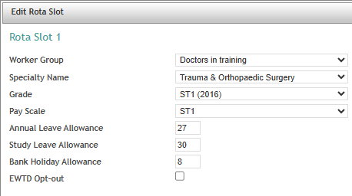
Rota settings: Slot Specific Settings
Worker Group: Grades of doctors who will work the rota. Example: Doctors in training
Specialty Name: Specialty this rota belongs to. Example: Urology
Grade: Grade of the doctor. Example: FY1 (2016)
Pay Scale: For some grades, there are different levels on the pay scale linked to the service of the doctor which will default the leave allowances accordingly. Example: F1 (+5)
Annual Leave Allowance: Annual Leave entitlement in days. Full time entitlement to annual leave relevant to time in NHS service (irrespective of FT or LTFT status – entitlements are pro-rata’d within the calculation if required). Example: 35
Study Leave Allowance: Study Leave entitlement in days. Relevant full-time study leave allowances relevant to training grade (irrespective of FT or LTFT status – entitlements are pro-rata’d within the calculation if required).This should default to full allowance, excepting the specific days of study leave which are timetabled and protected within a work schedule.
Bank Holiday Allowance: Bank Holiday entitlement in days.
Full time entitlement to bank holidays (irrespective of FT or LTFT status –
entitlements are pro-rata’d within the calculation).
EWTD Opt-out: Tick yes to record that this slot is for doctors who have opted
out of EWTD.

Slide 3
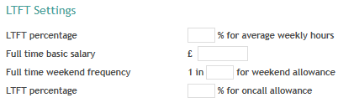
Rota settings: LTFT Settings
LTFT percentage: The agreed LTFT percentage
Full time basic salary: The basic salary for a full-time doctor at this grade (this will be pro-rated later within the calculations)
Full time weekend frequency: full time equivalent of weekend working, that will be pro-rated within the calculations in line with NHS Employers Ready Reckoner.
LTFT percentage: The percentage that the doctor is contributing to the on call rota and this gives them that percentage of the on call availability allowance. Example, 12% will be 12% of the full time on call allowance

